Slide 1


DriveEase
Car Rental
Project
Presented By
Ajay Paul
Narasimha
Rupesh
Vinay Yadav

Slide 2


Introduction
DriveEase prioritizes a seamless and enjoyable car rental experience.
Offers a wide range of vehicles, from luxury cars to budget-friendly options.
Simple, convenient rentals for travelers, professionals, and families.
Providing both high-end and economical vehicles for every occasion.

Slide 3
Purpose & Objectives
Diverse Fleet Selection – Offering both high-end luxury cars and budget-friendly options to suit every need.
Customer Convenience – Easy booking process, flexible rentals, and hassle-free service.
Safety & Hygiene – Well-maintained, regularly serviced, and sanitized vehicles for a secure ride.
Transparent Pricing – No hidden charges, fair pricing, and value for money.

Slide 4

Challenges in the Car Rental Market & Our Solutions
Limited Vehicle Availability – DriveEase maintains a diverse and well-stocked fleet to ensure availability year-round.
High Perceived Costs – We offer competitive pricing, discounts on long-term rentals, and transparent, no-hidden-fee policies.
Transparency & Hidden Charges – DriveEase provides upfront pricing and clear rental agreements to build trust and eliminate surprises.
Vehicle Quality & Maintenance – Our cars undergo regular servicing, cleaning, and quality checks to ensure a safe and smooth ride.

Slide 5
Our Goals
1
Deliver an exceptional customer experience by ensuring easy bookings, transparent pricing, and reliable service, fostering loyalty and positive reviews.
3
Optimize pricing strategies and implement loyalty programs to drive more rentals and higher revenue.
2
Drive more visitors to the website through SEO, digital marketing campaigns, and social media promotions, increasing brand visibility.
4
Continuously add diverse vehicle options to meet customer needs, from budget-friendly cars to premium and eco-friendly choices.

Slide 6




Technologies used
Software development technologies are the tools and methods that developers use to design, develop, test, and deploy software applications
HTML,CSS,JAVASCRIPT, BOOTSTRAP,ANGULAR
MYSQL DATABASE
C#, DOTNET FRAMEWORK
SELENIUM,JMETER,POSTMAN

Slide 7
Result
Requirements
Hardware Requirements:
8 GB RAM
Integrated Graphics / External graphics card
Software Requirements:
VS Code
Eclipse
Selenium

Slide 8






WireFrame Diagram:
User Login
Book Now
DriveEase
Home Cars About Contact
Home Cars About Contact
DriveEase
Home Cars About Contact
DriveEase
User Login
Login
After Successful Login
Car Image
Model & Price
Home Page
User
Email:
Admin
Password:
Sign In
Book Now
Sign Up
All Rights Reserved @DriveEase
Developed by Us
All Rights Reserved @DriveEase
Developed by Us
All Rights Reserved @DriveEase
Developed by Us
Admin Login
ManageCars ManageUsers ManageBookings Logout
Book Now
Admin Panel
Admin Panel
ManageCars ManageUsers ManageBookings Logout
Manage Bookings
Booking Details
Admin Panel Home Page
1) User Name
2)Car Model
3)Total Duration
4)Price
DriveEase
Home Cars About Contact
Booking form
Manage Cars
User Management
1)Username
2)Email
3)Phone Number
4)Pick Up Date
5)Drop Date
Admin Panel
ManageCars ManageUsers ManageBookings Logout
Admin Panel
ManageCars ManageUsers ManageBookings Logout
Book
Cancel
Car Management System
User Management
Car Management System
1)Brand
2)Model
3)Year
4)License Plate
5)Availability
1)Username
2)Email
3)Address
4)Phone Number
5)User
Add Car
Add User

Slide 9
Application Overview

Slide 10
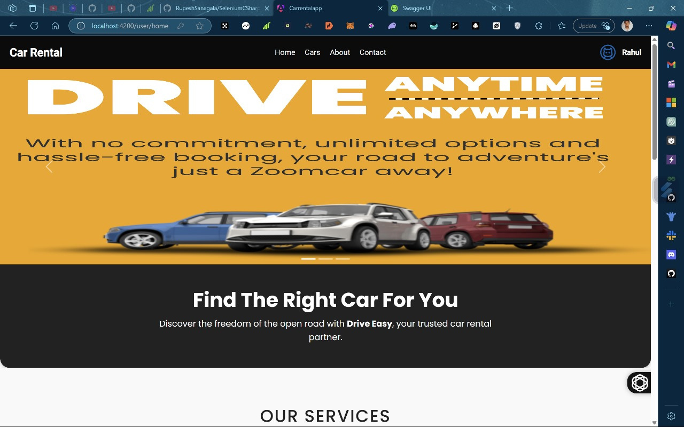
Home Page

Slide 11
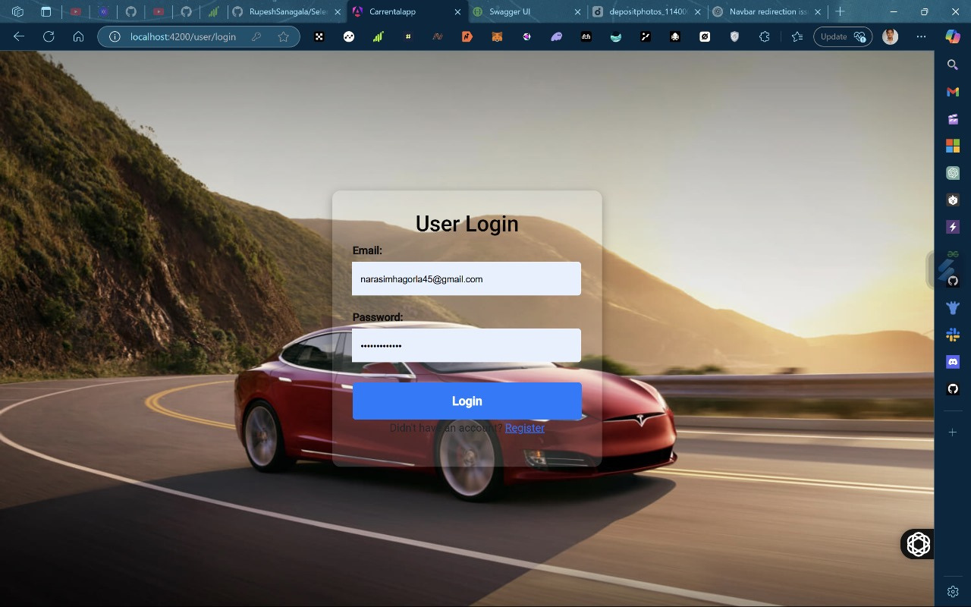
Sign In Page

Slide 12
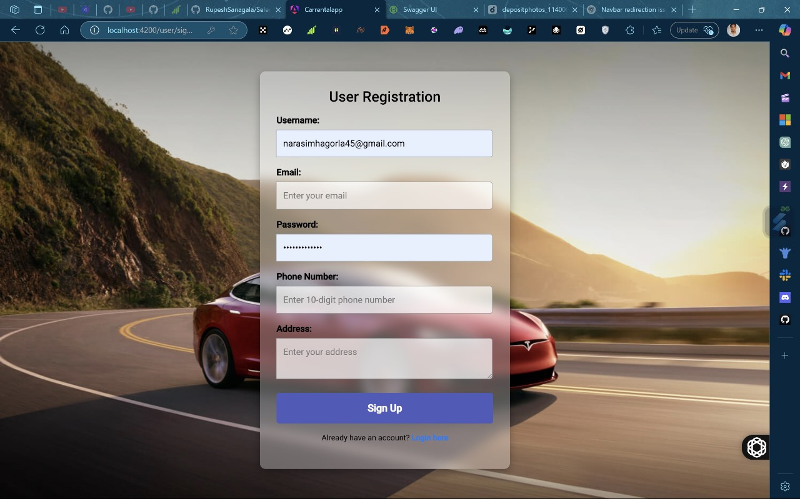
Sign Up Page

Slide 13
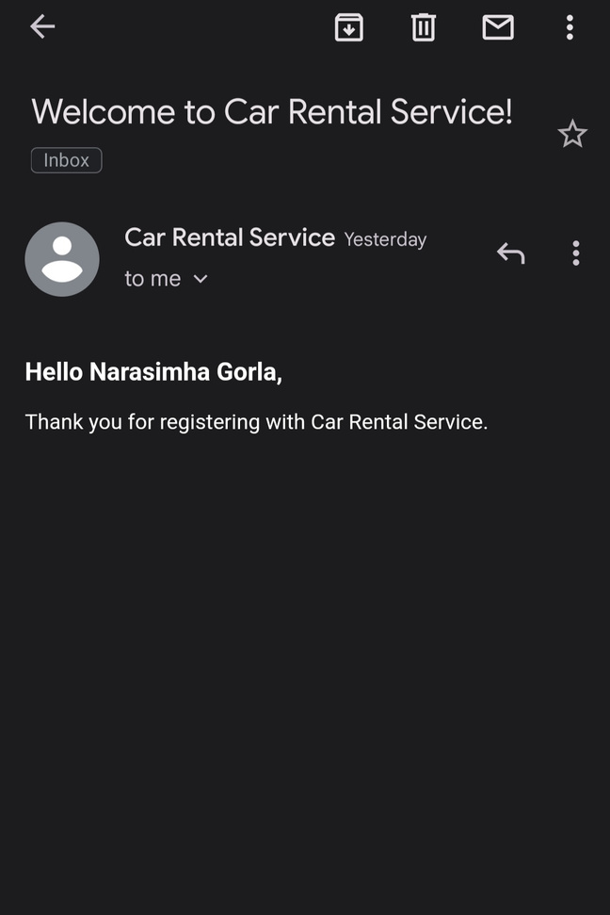
Sign Up Email Integration
User will get a notification to Email after successful registration

Slide 14
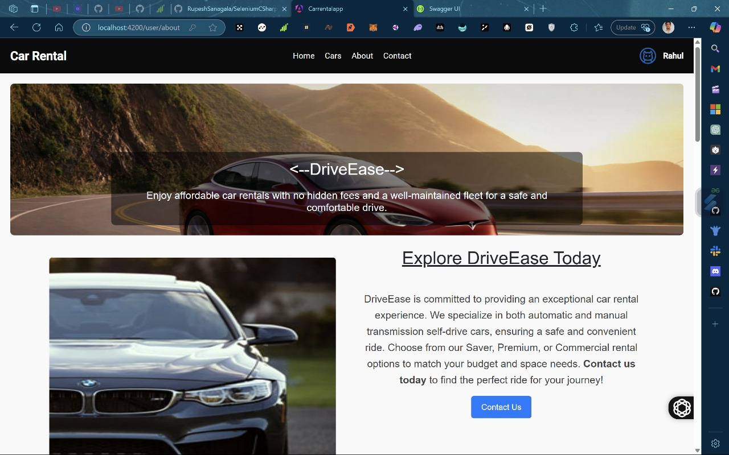
About Page

Slide 15
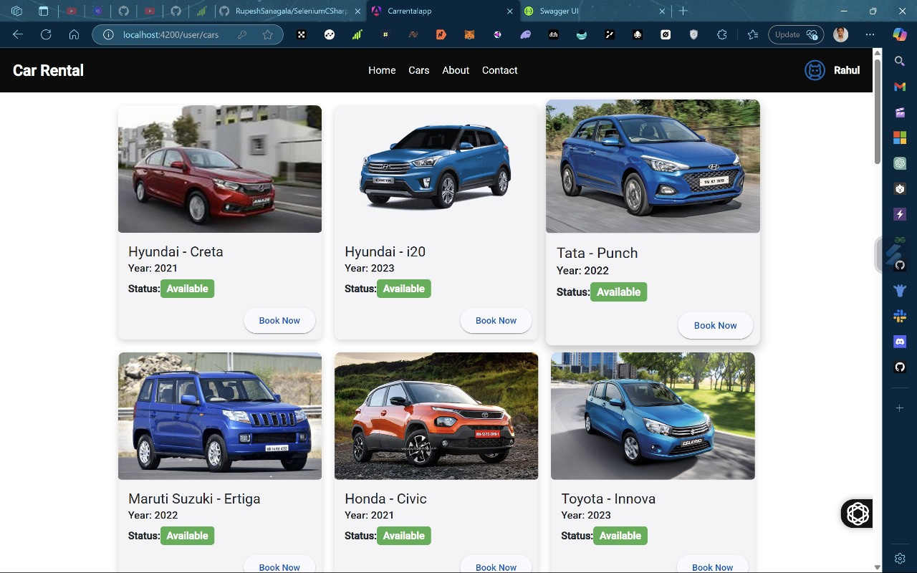
Cars Page

Slide 16
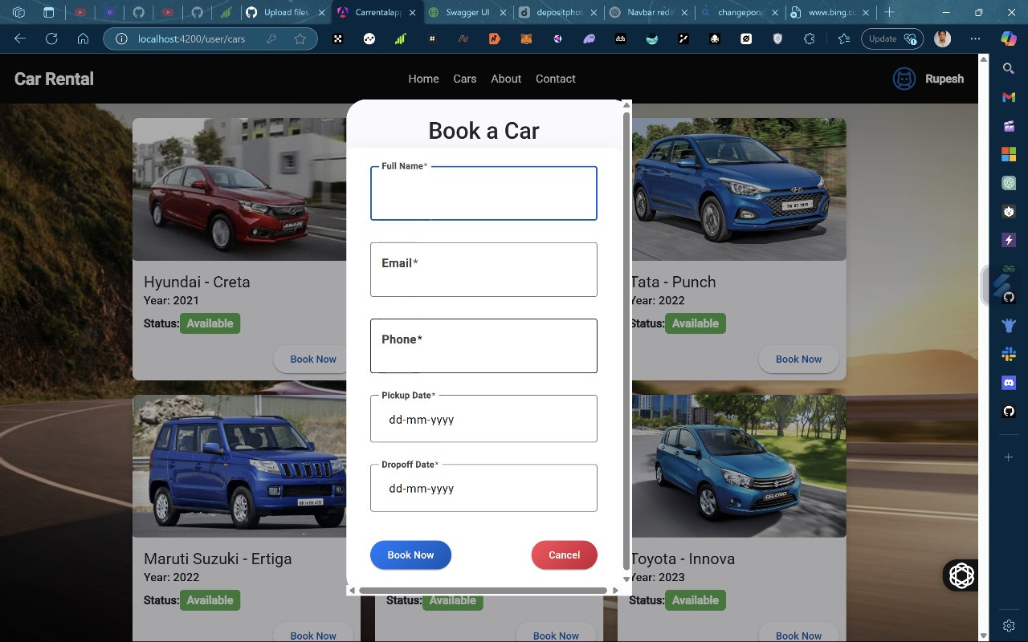
Booking Page

Slide 17
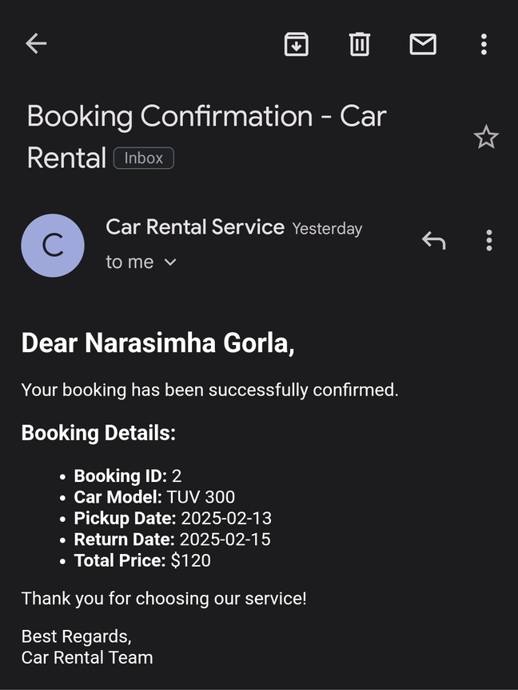
Booking Email Integration
User will get a notification to Email after successful Car Booking

Slide 18
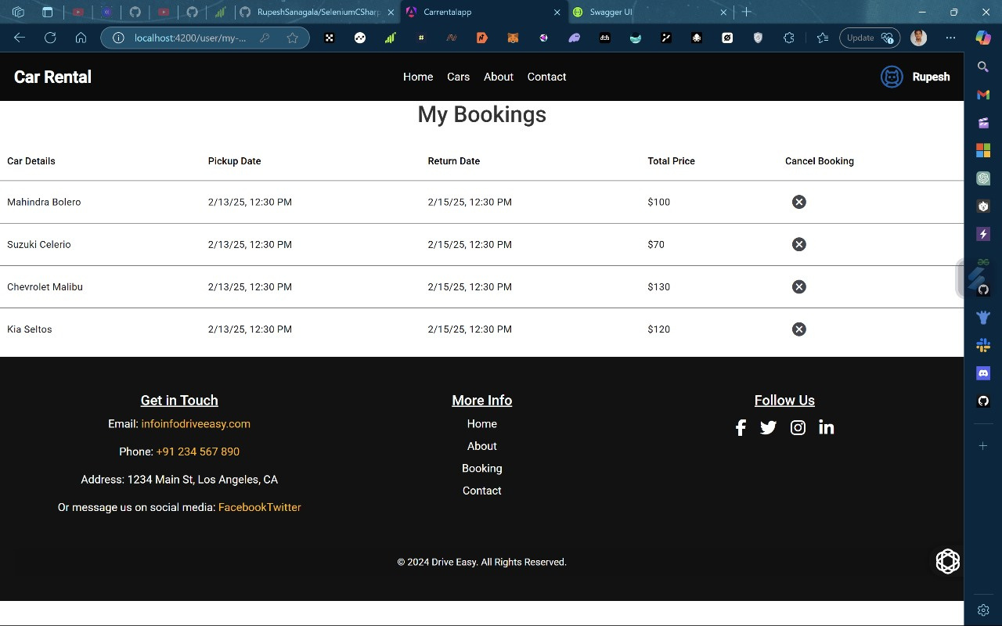
My Bookings

Slide 19
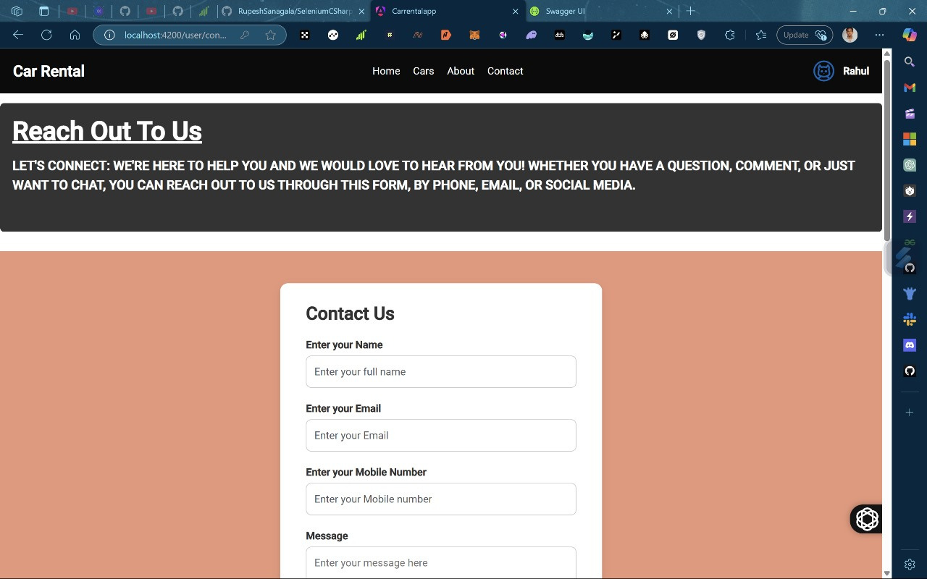
Contact Page

Slide 20
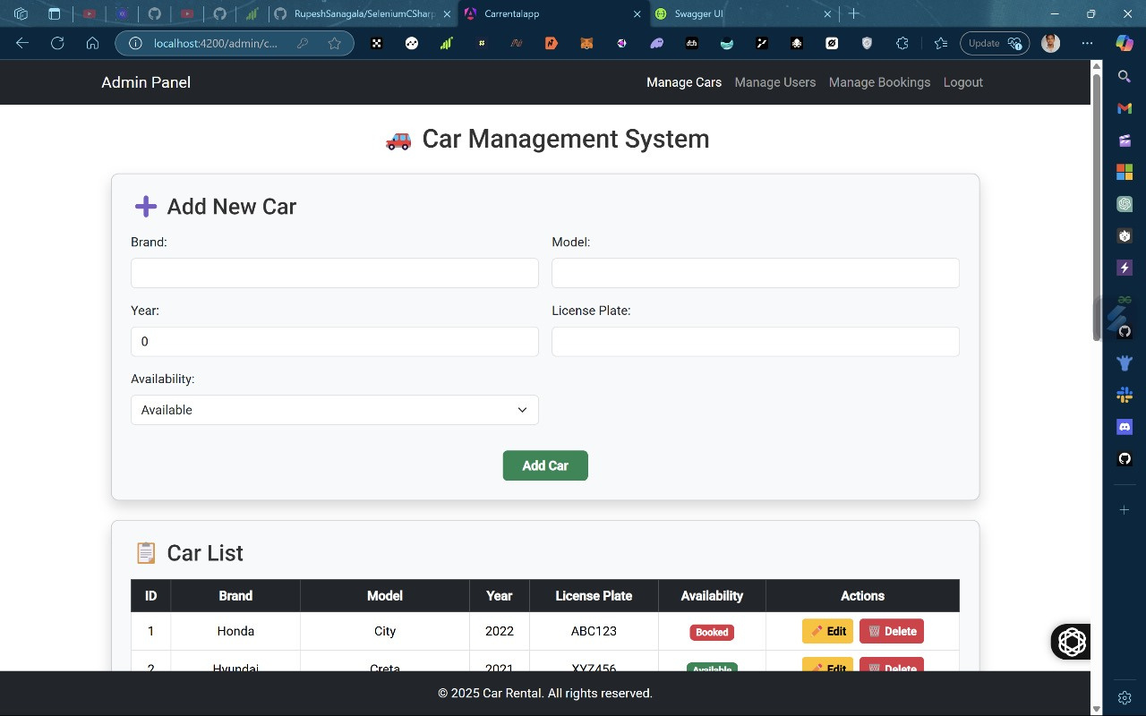
Admin Dashboard
Car Management

Slide 21
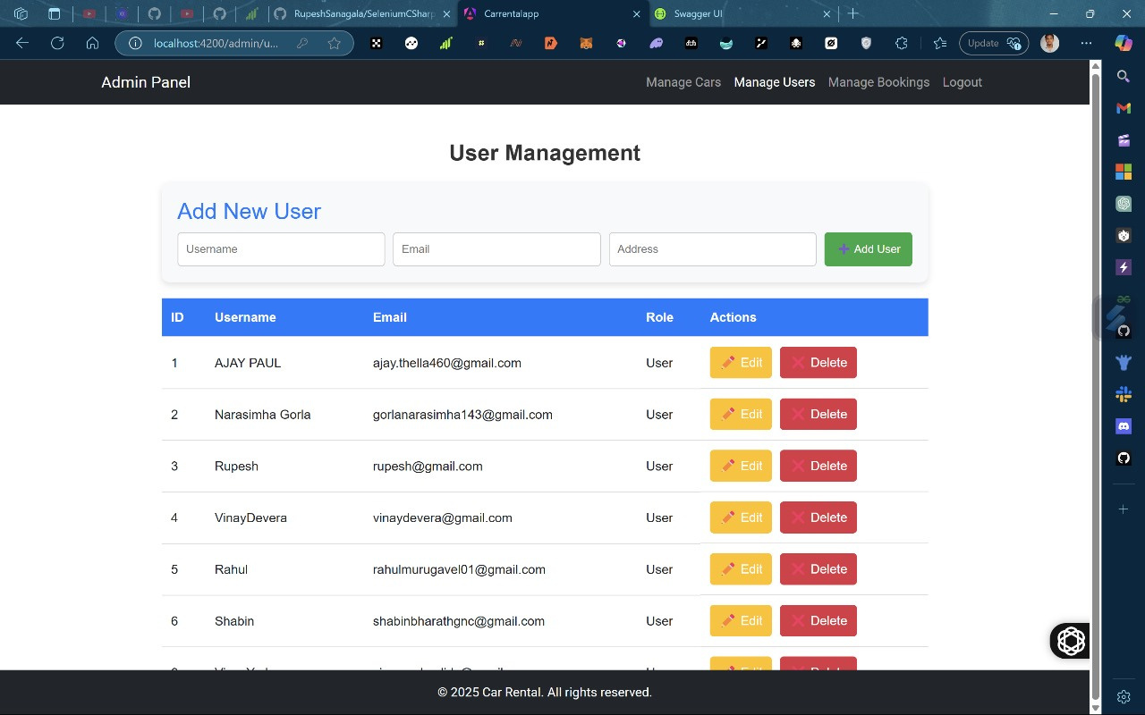
Admin Dashboard
User Management

Slide 22
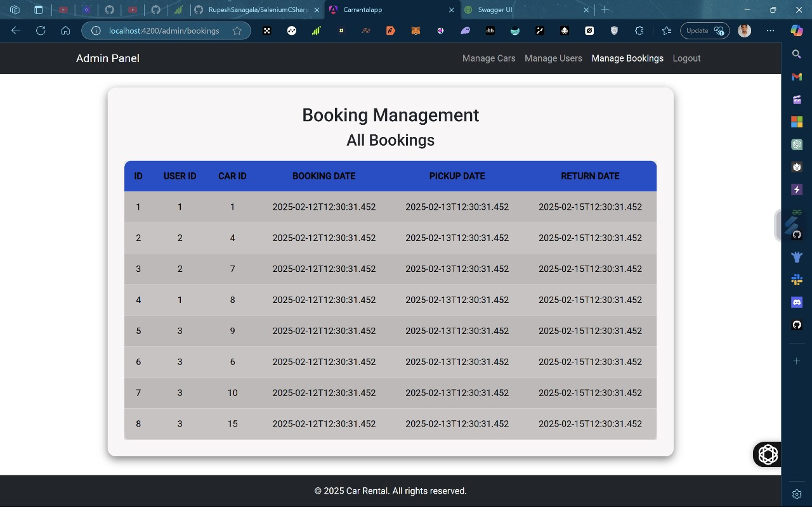
Admin Dashboard
Bookings Management

Slide 23
Conclusion
DriveEase is committed to providing a seamless, customer-focused car rental experience with a diverse fleet of vehicles, from luxury to budget-friendly options. We prioritize safety, transparency, and convenience, ensuring a hassle-free rental process. With well-maintained cars and clear, upfront pricing, we deliver value and reliability. Choose DriveEase for a smooth, enjoyable ride every time.

Slide 24

Thank
You

